Slide 1
Teaching Programming Fundamentals with Candy Catch
Anel Coralic, Austin Lanier, Carl Mickiewicz, Derek Phung

Slide 2
Who Are We?
Anel Coralic
Austin Lanier
Carl Mickiewicz
Derek Phung

Slide 3
What is TAP
The Technology Ambassadors Program (TAP) focuses on community outreach. This award-winning program also addresses a need to increase the number of students who persist in an IT major or minor, particularly those underrepresented in computing. TAP is a service-based learning course where students design a project to teach IT concepts.

Slide 4
Project Description
Create a fun cand catching game using Scratch, a visual programming language that uses coding blocks
Learn basic coding concepts like if-then and while statements

Slide 5
Pre-Survey

Slide 6
Candy Catch
https://scratch.mit.edu/projects/481519033/

Slide 7
Programming Concepts
If-Then Statement: An if-then statement is a concept that specifies the execution of an action when a condition is true, or another action is done. Example: “If the "d" key is pressed, then the user will move 10 spaces right”.
While/Forever Loop: All the code in the loop will execute forever as long as the program is running. A forever loop allows the candy in our game to constantly fall, rotate, and re spawn at the top of the screen.

Slide 8

What is Scratch
Scratch is a block-coding based software to introduce basic coding concepts to beginners through interactive games.

Slide 9
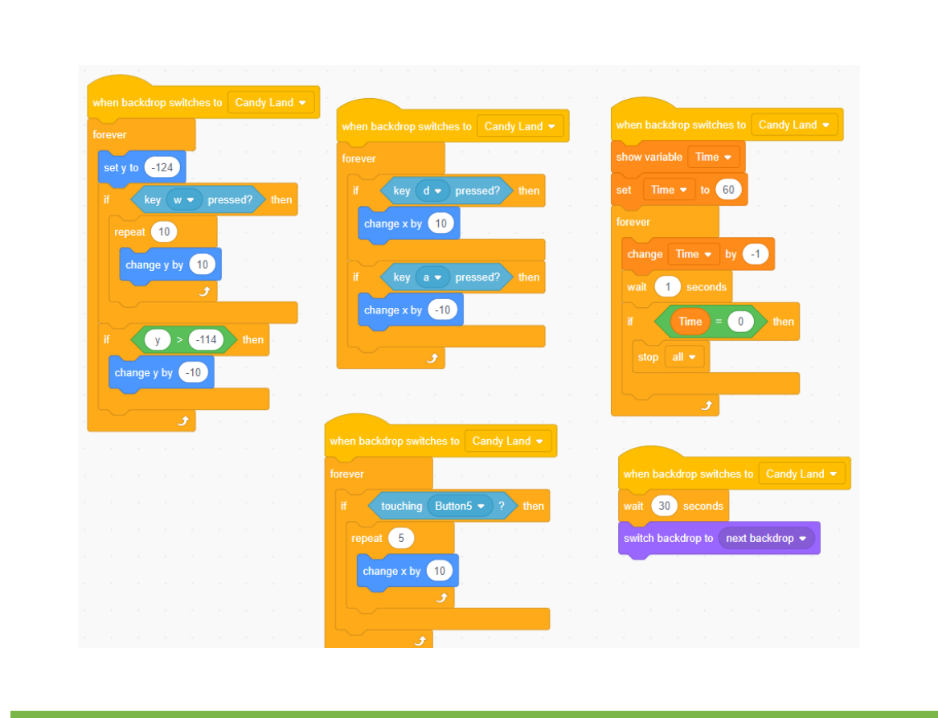
Block Coding
Block Coding utilizes a drag-and-drop learning environment where programmers use blocks to construct basic programs.

Slide 10
Scratch Link
https://scratch.mit.edu/projects/507324213

Slide 11
Post Survey

